Slide 1
NORTHWELL HEALTH
HEALTH HOME
Program Information

Slide 2



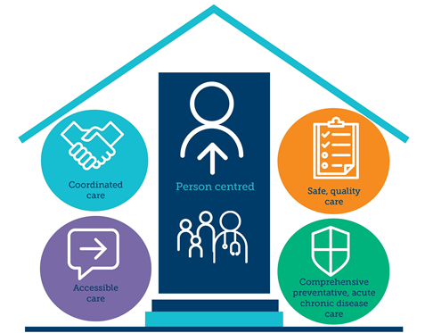





HEALTH HOME – PROGRAM OVERVIEW
Northwell Health's Health Home (for adults and children) is a New York State Medicaid care coordination program that provides access to medical, mental health, substance abuse, social and family support services to individuals who need them. Health Home services are free to those who qualify.
Program Goals
Eligibility Requirements
Connect vulnerable, hard-to-reach populations to care
Reduce unnecessary utilization with a focused care transitions program
Improve health education & health literacy through disease management
Highlight preventive care services through focused closure of HEDIS care gaps
Assist with social service needs & connections to community providers & resources
Ensure coordination across care continuum through relationships built with providers
Active Medicaid &
2+ Chronic Conditions (Any) OR 1 Single-Qualifying Condition:
  HIV/AIDS
  Sickle Cell Disease
  Serious Mental Illness (Adults)
  Serious Emotional Disturbance
  Complex Trauma
Utilizing a Person-Centered approach, we’ve served over 53,000¹ of the most vulnerable patients of the Northwell Health system –
Medicaid beneficiaries with multiple medical & behavioral health conditions.
Members work collaboratively with their care manager and team, addressing:
Social Needs
Linkage to resources such as food pantries, housing resources, and benefits applications (SSI/SSD/Temporary Assistance)
Medical Needs
Linkage to providers and provider collaboration, with the goal of improving healthcare access, and overall member health knowledge and outcomes
Behavioral Health Needs
Linkage to BH providers, assistance with managing diagnosis and transition to specialty programs designed to provide support tailored to a member’s needs
General Support Needs
Identification of secondary caregivers, family support systems, linkage to respite services and connection to general support systems and community resources.
¹Enrollments over 5-year period

Slide 3








HEALTH HOME – MEMBER JOURNEY
Throughout a member’s enrollment with Health Home, several key steps occur to address a member’s needs and empower them to achieve positive outcomes.
Start
Outreach & Enrollment
Care Planning
Goal Setting and Core Service Delivery
Education
800+ Adult enrollments per month
100+ Child enrollments per month
Patients are engaged face-to-face at hospital facilities, outpatient practices, & in the community
Identifying Immediate Needs
A Care Plan is created in collaboration with the member in the first 56 days of enrollment to address medical, social, & mental health goals, strategies, & interventions
2.97 average touches per month (Adults)
4.9 average touches per month (Children)
Monthly care management coordination activities include linkage to social services & community resources, health promotion, & transitional care, while working to meet a member’s goals in their plan of care.
Promoting Healthy Outcomes
Care Management works with the member to educate on managing disease, importance of annual check-ups, improving overall health as well as provide family support & education (E.g., Managing symptoms in the home)
Graduation
Member Graduation
Completion of Goals
Service Referral & Linkage
Provider Collaboration
15 Month average L.O.S.
Member has met their goals established by their care plan & is stepped-down or graduated from the program with a transition plan
Empowering Our Members
Care Management works with the member to address all social, medical and related needs as identified by the member, with the goal of elevating the member to self-manage their medical and social needs
Community-Centered Connections
Members are screened for needs and connected to immediate community resources including food, housing, benefits, etc., as well as advocacy for children’s school-based services including accommodations, learning devices, supports, and referrals to EI & HCBS Waiver services
Addressing Health needs
Care Managers collaborate with providers to address any health needs, gaps in care, and work together to assist the member in improving their health outcomes and other needs.
¹Enrollments over 5-year period

Slide 4




MODEL OF CARE
Health Home is the purveyor of all Medicaid care management.
1
Linkage to Social Services
Rental Assistance
Social Security
Transportation
SNAP
Community Health Workers
Social Determinants of Health
Interdisciplinary Team Model
Connection to Community Providers
2
Care Management Coordinators
Nurses
Episodic Care Management
Care Transitions
Behavioral Health
High Risk
Patient-Centered
Care Management
Gaps in Care
Care Planning
Case Conferences
Health Education

Slide 5



SOCIAL DETERMINANTS OF HEALTH
Social Determinants of Health linkage is the foundation of the Health Home program.
Screening Tool
Our uniform assessment allows members to self-identify sensitive social issues that impact their lives at the time of enrollment. By incorporating a social model of health & removing the sole focus of body function, structure & disease alone, it creates the ability to assess & identify needs in real time.
Community Health Workers
8,385
Total Referrals Submitted
(2025 YTD)
3,463
Total Linkages
(2025 YTD)
We train & employ CHWs who leverage their relationships & expertise in navigating social services. When needs are identified, a CHW is assigned to provide connectivity to the appropriate resource(s) in the community.
Workflow
Identification
Referral
Assistance
Care Manager identifies SDOH need(s) through uniform assessment
Care Manager refers member to CHW team
for assignment
CHW works with member, assisting with identified need(s)
2,739
Total Referrals Submitted
(2025 YTD)
1,573
Total Linkages
(2025 YTD)
¹Enrollments over 5-year period

Slide 6






GAPS IN CARE
Our care managers are trained to provide health education & highlight the importance of preventive care services to members.
We developed a successful closure strategy by leveraging relationships built with providers, using innovative technologies,
& collaborating closely with Managed Care Organizations at monthly meetings.
25
HEDIS Measures
Targeted
66%
Gaps Actioned
(2025 YTD)
44%
Gaps Closed
(2025 YTD)
2023 Northwell Health Home Closure Rates*
2025 YTD Payer Outcomes
Measure
Cervical Cancer | -- | 72% | 81%
Breast Cancer | 63% | 65% | 84%
Diabetes screening for people with schizophrenia | 74% | 75% | 84%
SUD 30 day follow up | 25% | 25% | 91%
*Latest Data provided by Centers for Medicare and Medicaid Services (CMS)

Slide 7




CARE TRANSITIONS & CLINICAL ESCALATION
Through readmission meetings, episodic care collaboration, & a team-based model, we support patients’ recovery after a hospitalization, ensuring safe transition back into the community, reducing readmissions, & decreasing total cost of care.
Adult Standard Transitions of Care
Pediatric Standard Transitions of Care
Behavioral Health Rapid Transitions
Weekly readmission meetings with the medical director & RNs are used to discuss milestones & readmission reasons, allowing for the co-management of escalated cases.
Close collaboration with care team members and providing education to caregivers are core elements to ensuring our pediatric population avoid preventable hospitalizations.
Abbreviated 30-day program, to provide intensive, evidence-informed care transition interventions for patients discharged from a behavioral health inpatient setting.
1,432
104
Monthly Avg. Inpatient Alerts (2025 YTD)
Monthly Avg. Inpatient Alerts (2025 YTD)
48-Hour Call:
52%
48-Hour Call:
100%
Appointment Attended:
68%
Appointment Attended:
78%
All-Cause
Readmission:
17%
All-Cause
Readmission:
14%
All-Cause
Readmission:
13%
NYS Average Readmission Rate, Medicaid = 26%
¹Enrollments over 5-year period

Slide 8
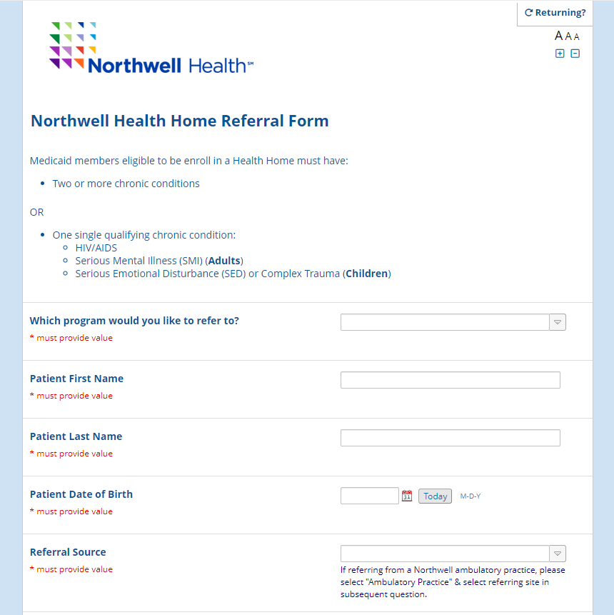
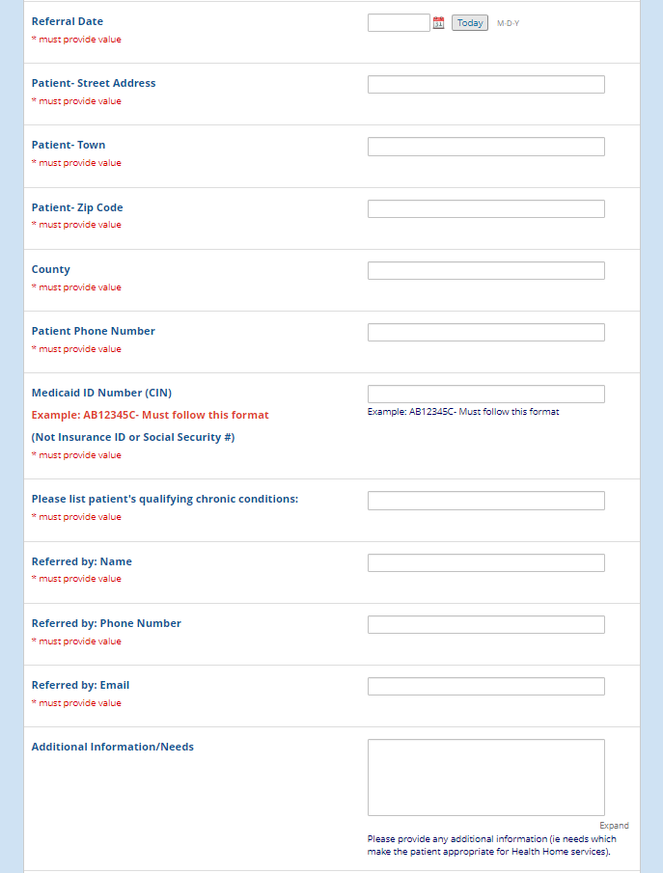



MAKING A REFERRAL
REDCAP Referral Form
PHONE
888-680-6501
EMAIL
HHCommunication@northwell.edu
HHChildren@northwell.edu
REDCAP
Health Home Referral Link
¹Enrollments over 5-year period

Slide 9
Thank you!

